Slide 1
Welcome, Introduction and Administration
CFS
1
Second Edition
Updated July 2025

Slide 2
Course Learning Objectives
Upon course completion, learners should be able to:
Manage a PFM Program at the
Command Level
Conduct Effective PFM Education
and Training
Provide Appropriate Information
and Referral
Conduct Effective One-on-One
Counseling

Slide 3
Financial Training Topics
Million Dollar Service Member Course (2 Days)
CFS Course (3 Days)
CFS Training Process
SM
1-2

Slide 4
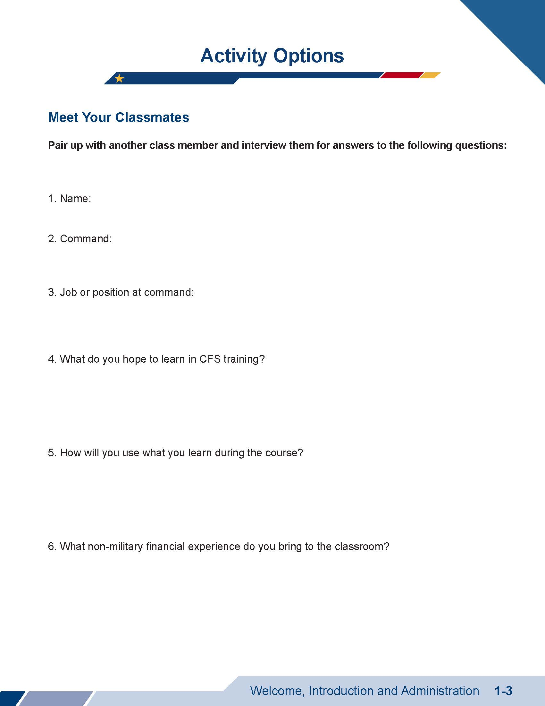
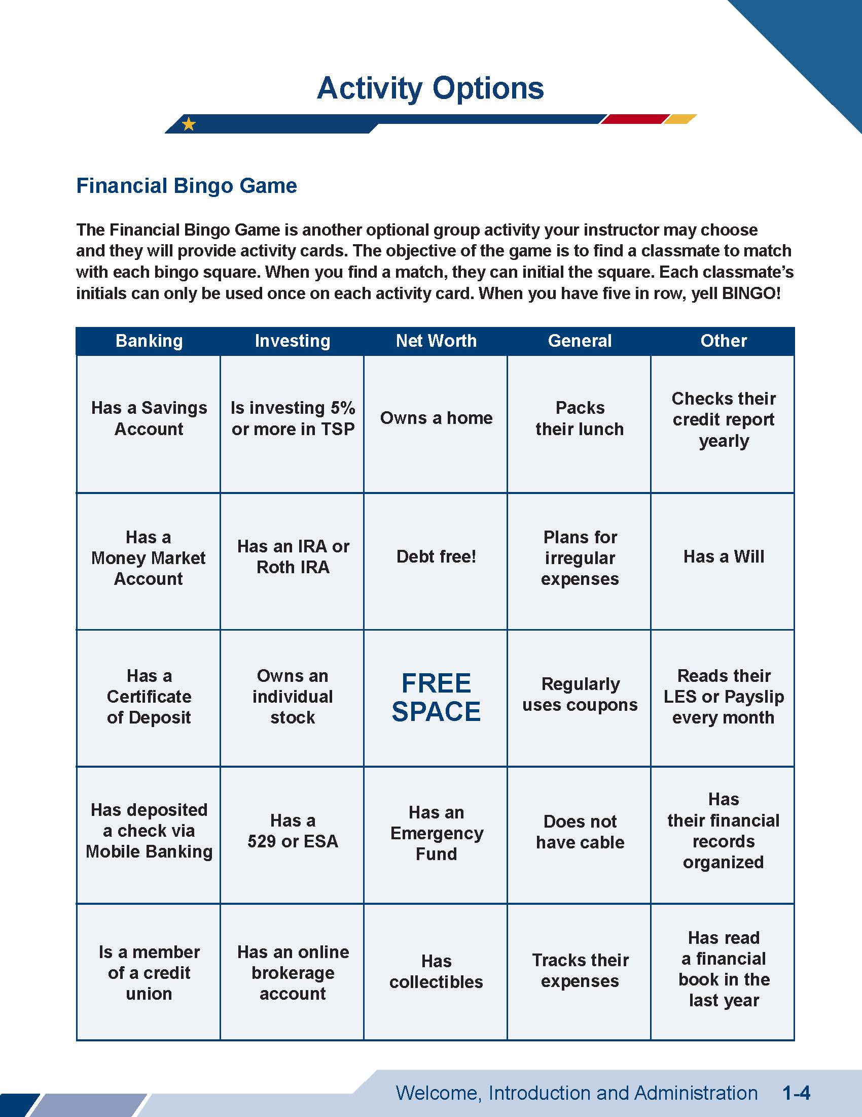
Learner-centered Activity Options
Meet Your Classmates
Financial Bingo
SM
1-3

Slide 5
Student Manual Overview
CFS
Chapters
Chapter
Organization
Terms and
Acronyms
Common CFS Task Areas
SM
1-5

Slide 6
Common CFS Task Areas
Education
and
Training
Information
and
Referral
TASK
Counseling
SM
1-6

Slide 7






Other Course Materials
DoD Learning Resource Library & Service Specific CFS Portal
Learner-centered
Activities
Dot-com Disclaimer
Course Evaluations
Daily Homework
Pretest/Post-test
SM
1-7

Slide 8



Course Expectations for Learners
Positive Environment
Participation
Confidentiality

Slide 9

Course
Agenda
Introduction to CFS
Introduction to Core CFS Functions
DAY 2
Tools & Resources
DAY 3
Program Development
SM
1-9

Slide 10






Facility and Classroom Policies
Refreshments / Lunch
Cleanup Duty
Cellphone Usage
Restrooms
Smoking Area
Parking

Slide 11
Administration
Course Paperwork
Orders
Contact Information
Contact Nearest PFM

Slide 12
Enjoy the Training!
The appearance of U.S. Department of Defense (DoD) or U.S. Department of Homeland Security (DHS) visual information does not imply or constitute DoD or DHS endorsement.

