Slide 1
#blendedretirement
The Uniformed Services
Blended Retirement System
January
1
2018
Introduction to the
Blended Retirement System
March 17, 2017
PERSONNEL AND READINESS
Notes:
The National Defense Authorization Act for Fiscal Year 2016 established a modernized retirement plan for the Uniformed Services. As written into the law, the Uniformed Services have until January 1, 2018, to implement this new retirement system and fully educate the force.
The Department of Defense refers to the modernized retirement system as the “Blended Retirement System” or “BRS.”
The implementation of the BRS is the most wide-reaching and significant change to military pay and benefits since the advent of the All-Volunteer Force. Accordingly, we are aggressively working to implement these changes, train the force about the new retirement system, and manage all of the myriad changes to systems and policy such a large effort requires.
Today, I am going to be discussing many of the features of the BRS as well as our ongoing efforts to implement the new system.

Slide 2
Disclaimer
This is an informational policy briefing ONLY and is not intended to provide service members with the financial knowledge necessary to make an opt-in decision.
This briefing DOES NOT replace the mandatory Blended Retirement System Opt-In Training Course that MUST be completed by all eligible service members.
Notes:
First, it is important to note, today’s policy briefing does not satisfy the requirements to complete the mandatory Joint Knowledge Online (JKO) BRS Opt-In Course. The BRS Opt-In Course is designed to provide all opt-in eligible service members with basic financial concepts and a comparison of both retirement systems. This presentation is informational only.

Slide 3
The Military Retirement Benefit
Legacy Retirement System
Defined annuity benefit computed as
Must serve at least 20 years
Blended Retirement System, blends:
Defined annuity becomes
Automatic & matching TSP
2.5%
X
X
Years Served
Retired Pay Base
Only 19% Active and _{14%} Reserve Qualify
2.0%
X
X
Years Served
Retired Pay
Base
Member’s TSP Contributions
DoD Automatic 1% into TSP
DoD Matching TSP Up to 4%
Monthly Retired Pay
TSP Earnings
Includes Lump Sum Option
After 60 days
After 60 days
After 2 years
After 20 years
Retirement Age
Service members who leave after just 2 years will keep TSP savings + DoD Contributions + Any Earnings
85%
of all service members will get retirement benefits
Notes:
Legacy Retirement System
Under the Legacy Retirement System, which we often call the “High-3 System,” because the retired pay is based on an average of a Service member’s highest three years of pay, Service members who complete at least 20 years of active military service are eligible to receive monthly retired pay (aka defined annuity). The retired Service member receives monthly retired pay based on years of service and a percentage of a Service member’s pay. How we arrive at that amount of money is represented by the formula you see at the top. Their years of service are multiplied by 2.5% to determine a percentage.
It’s important to note, that generally if a service member doesn’t make it to 20 years, they do not receive a government retirement under this system.
Under the legacy retirement system today, only 19% of active component Service members qualify for monthly retired pay, and only about 14% of our National Guard and Reserve population. This means approximately 81% of active Service members and up to 86% of reservists leave military service with no government retirement benefits.
Blended Retirement System:
The new Blended Retirement System combines the legacy 20-year military retirement system (the defined annuity), with a defined contribution plan, known as the Thrift Savings Plan or TSP, as it’s more commonly referred too.
The defined contribution component or TSP, includes automatic 1% DoD contributions after 60-days and up to 4% additional matching contributions after two-years of service to the member’s TSP account.
The new Blended Retirement System will now ensure nearly 85 percent of military Service members leave the service with retirement benefits. NOTE: The reason for 85% and not 100%, is because the attrition rate is generally 15% within the first two years.
The trade-off, as matching TSP contributions are incorporate under the BRS, the annuity is lowered. The formula for calculating retired pay will use a 2.0% multiplier for each year of service rather than 2.5% under the legacy system.
Under both retirement systems, the service member can still earn a defined annuity, providing monthly retired pay for life.
But…as you see at the bottom, BRS will provide retirement benefits to approximately 85% of the force, rather than the 19% who receive benefits under the legacy system.

Slide 4
Who is Affected?
If serving as of December 31, 2017:
GRANDFATHERED in current retirement system
NO ONE will be automatically moved to BRS
Many currently-serving members eligible to opt into BRS
Active: Fewer than 12 years of total service as of Dec. 31, 2017
Reserve: Fewer than 4,320 retirement points as of Dec. 31, 2017
Eligible members have all of CY 2018 to make their decision
Member wants to stay covered under current system – do nothing
Member decides BRS is better – can opt in
New accessions on or after January 1, 2018 covered by BRS
Notes:
Everyone currently serving in the Uniformed Services as of December 31, 2017 will be grandfathered under their current retirement system.
NO ONE will be automatically moved to the Blended Retirement System. You will have to physically make the opt-in election.
Those active component Service members with more than 12 years of total service and Reserve Component Service members with more than 4,320 retirement points as of Dec. 31, 2017, will remain under the legacy retirement system.
But some Service members may have a choice to make.
If you are in the Active Component and have less than 12 years of total service or in the Reserve Component with less than 4,320 retirement points as of January 1, 2018, will have the choice of whether to stay with the legacy retirement system or opt in to the new Blended Retirement System.
New accessions after January 1, 2018, will automatically be enrolled in the new Blended Retirement System.

Slide 5
Blended Retirement System Basics
Defined Benefit
For non-regular retirement, at age 60 or earlier with creditable active service
Basic qualifications for retirement do not change
The pension is still the primary component of military retirement
Years of Service
High-36 Month Average of Base Pay
2.0% x x =
Monthly Retired Pay
Defined Contribution
Individual Contribution | Agency Automatic Contribution | Agency Matching Contribution | Total TSP Monthly Contribution
0% | 1% | 0% | 1%
1% | 1% | 1% | 3%
2% | 1% | 2% | 5%
3% | 1% | 3% | 7%
4% | 1% | 3.5% | 8.5%
5% | 1% | 4% | 10%
AFTER 60 DAYS
AFTER 2 YEARS
NOTE: Currently serving members who opt-in will see matching contributions immediately
Continuation Pay
Lump Sum
Mid-career incentive designed to maintain force retention
Payable between 8 and 12 years of service
AC: 2.5x to 13x monthly basic pay (RC: 0.5x to 6x)
May elect lump sum of 25% or 50% at retirement
Discounted present value from retirement to age 67
At age 67, reverts back to full annuity
Notes:
Let’s take a more detail look at the new Blended Retirement System.
MONTHLY RETIRED PAY: For those who retire after at least 20 years of active service, the retirement remains predominantly a defined benefit in which the Service member will get monthly retired pay.
Instead of being calculated at 2.5 percent times the average of the Service member’s highest 3 years of basic pay, the Service member’s monthly retired pay will be calculated with a 2.0 percent multiplier.
TSP: In addition, the Blended Retirement System includes a TSP component.
New Accessions:
All new accessions after January 1, 2018, will be automatically enrolled into the TSP at 3% of their base pay, with automatic 1% DoD contributions starting after 60 days, and DoD matching up to 4% at the start of the third year of service.
Both the DoD automatic 1% and the matching contributions continue through the end of the pay period during which the Service member attains 26 years of service.
Opt-In Service Members:
Current Service members who opt-in to the new Blended Retirement System between January 1, 2018, and December 31, 2018, will receive DoD automatic 1% contribution of their basic pay and up to 4% additional DoD matching beginning the first pay period of election. There is no 60 day or two year waiting period, as there is with new accessions.
CONTINUATION PAY: The law also included a continuation pay provision as a way to encourage Service members to continue serving in the Uniformed Services.
Continuation Pay is a direct cash payout, like a bonus.
It is targeted at the mid-career mark, payable between completion of 8 years of service and before completion of the 12th year of service.
Minimum for AC is 2.5x monthly basic pay up to a maximum of 13x
Minimum for RC is 0.5x monthly basic pay (of active duty) up to a maximum of 6x (AGR/FTS receive active component rates)
Each Service will determine when and at which rate continuation will be paid-out. The Services’ continue to work on this provision.
LUMP SUM: The lump-sum option gives Service members choices at retirement.
The lump-sum option allows Service members to choose to elect 25% or 50% lump-sum payment at retirement in exchange for reduced monthly retired pay until the Service member reaches full Social Security retirement age, which for most is 67 years old.
It is important to note, that the lump sum is discounted to the present value, it is not the same dollar amount a service member would receive if they continued to receive the full annuity over this period of time.
The formula for calculating the lump sum discount rate is based on the Department of Treasury published market rates and will be published each year. The discount rate for 2018 will be published on June 1, 2017.
For the Reserve Component the lump sum option is available at age 60 (non-regular retirement) or earlier based on creditable active service.

Slide 6
Lump Sum Option
Regular Retirement
50% of future retired pay to age 67
NO LUMP SUM
$
Enlistment
Retirement
Age 67
discounted present value
Reverts to Full Pension
50% Lump Sum
$
Reduced Pension
LUMP SUM
Enlistment
Retirement
Age 67
Notes:
The lump-sum option is a new option for service members under the Blended Retirement System, providing choices at retirement.
Ninety days prior to retirement, a service member may choose to receive either 25-percent or 50-percent of the discounted present value of their future retirement payments.
That percentage is calculated from the date of retirement to full Social Security retirement age, which for most is 67 years old.
This lump sum election is paid out no later than 60 days after retirement, in exchange for reduced monthly retired pay.
Monthly retired pay returns to the full amount when the service member reaches their full Social Security retirement age, again, which for most is 67 years old.
The discount rate for the lump sum will be determined annually and announced by DoD each June 1.
Important to note, lump sum payments are considered taxable income. However, service members may choose to receive their lump sum payments in up to four installments over four years to reduce their tax burden.
**For the Reserve Component, a non-regular retirement slide is located at the back of this presentation.
The lump-sum option allows service members to choose to receive 50-percent or 25-percent of the discounted net present value of their future retirement payments at retirement in exchange for reduced monthly retired pay until the service member reaches full retirement age. The monthly retired pay reverts to the full pension amount when the service member reaches Social Security retirement age, which for most will be 67 years old. No such lump-sum option exists under the legacy military retirement system.
NOTE: The law establishing the Blended Retirement System directs the Secretary of Defense to consider personal discount rates in establishing the discount rate used to determine the lump sum payment amount. The Department has made no decisions on personal discount rates. The DoD continues to work on guidance related to this provision of the Blended Retirement System.

Slide 7
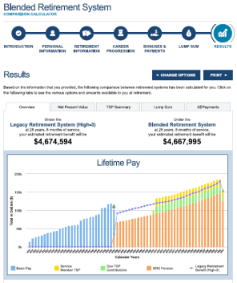
Implementation Timeline
2016
January
Policy Signed
Discount Rate Published
1
Opt-In
Training Began
2018
Enacted by Congress
Financial Educators Course Released
OPT-IN
WINDOW
OCTOBER
JANUARY
JUNE
2017
2016
2017
2018
JUNE 1
DECEMBER
MARCH
DECEMBER 31
JANUARY 1
DECEMBER 31
Leader Course Released
Eligible Opt-In Members Notified
BRS Goes
Into Effect
Opt-In
Period Ends
Last Date of Eligibility for Coverage Under Legacy Retirement System with opportunity to Opt-In to BRS
2018
Online Comparison Calculator Available + Calculator eTutorial
New Accessions Course Released
All New Accessions Covered Under BRS
Notes:
The following timeline outlines major milestones along the way towards implementation of the Blended Retirement System.
A few key milestones I’d like to highlight:
January 31, 2017, Opt-in Training begins: Members with fewer than 12 years of service as of December 31, 2017 (or fewer than 4,320 retirement points in the case of Reserve Component members) are grandfathered under the current retirement system, but will be eligible to opt-in to BRS. This is a required course and will aid eligible Service members, both active and reserve, in understanding and comparing the legacy and new retirement systems.
Spring 2017: Comparison Calculator goes live: Will allow Service members to compare their anticipated benefits and investment earnings under both the Legacy retirement system and the BRS.
June 2017: OSD will publish the lump sum discount rate for 2018. This rate will be published annually in June for the following calendar year based on the market benchmark + adjustment factor.
January 1, 2018 – December 31, 2018, OPT-IN WINDOW: The opt-in or election period for BRS will begin January 1, 2018 and conclude on December 31, 2018.
January 2018: Training for all new accessions is released, providing a summary of their retirement system and their options for investing in TSP.

Slide 8
BRS Training
June
Leader Course: Provides leaders a basic familiarity of BRS and an understanding of “opt-in” and major milestones for implementation. Available as of June 1, 2016.
2016
October
Financial Educator Course : Counseling scenarios to equip financial professionals and retirement experts. Available as of October 2016.
2016
Opt-In Course: Provides “opt in” population a comparison of current and new retirement systems as well as training on the importance of lifelong saving for retirement. Computer-based course was released January 31, 2017. Course is MANDATORY for all identified as “eligible to opt-in”
January
2017
January
New Accession Course: Specialized course for members who join the service on or after January 1, 2018; highlights the new components BRS and includes retirement planning calculators.
2018
Notes:
The DoD has initiated an 18 month long multi-stage financial education training curriculum to fully prepare Active and Reserve component members and their families. These courses will be available on Joint Knowledge Online (JKO) .
The Leader Course is designed to provide military and civilian leaders with an understanding of the key components of BRS and the DoD plan to educate the force, including retirement plan comparisons, key milestones, and an overview of the opt-in option for Service members. Although geared towards leaders, BRS-LC is available to all Service members on JKO and MilitaryOneSource.mil. Anyone looking for additional information is encouraged to take the course.
The second course is the Personal Financial Counselors/Educators Course. This course will focus on various counseling scenarios to equip financial, retirement and similar advisers who assist commanders.
The Opt-in Course is a required course for all eligible Service members. It provides eligible Service members, both active and reserve, a comparison between the legacy and new retirement systems, equips service members with financial planning and retirement concepts and real-life scenarios. Service members will use the knowledge gained from this course combined with their personal assessments of career goals and financial situations to decide which retirement system is best for them. It was launched on January 31, 2017.
Finally, the New Accession Course is geared to Service Members who begin their service on or after January 1, 2018, will be covered by BRS. All new Service members will be required to complete BRS-NAC within their first year of service.

Slide 9
Mandatory Opt-In Training
This policy briefing does NOT count for your mandatory BRS opt-in training.
Mandatory training can be completed via:
Joint Knowledge Online (CAC required)
Military One Source (non-CAC enabled)
Via some Service’s learning management systems
Pre and Post test, plus checks on learning, ensures knowledge transfer
Course is approximately 2 hours.
Turn in your certificate of completion to your training manager.
Notes:
Again, the briefing today does not meet the mandatory opt-in training requirement. That training can only be accomplished on Joint Knowledge Online (JKO) or on your Service’s learning management system (if available), via Military One Source (non-CAC enabled), or in some limited circumstances, group training utilizing the official JKO PowerPoint presentation (96-slides) and associated facilitator guide.
In all, the mandatory BRS opt-in course training will last approximately 2 hours online or 2-3 hours via the group setting.
Ensure that if you take the course outside of JKO, or your Service’s learning management system, that you turn your certificate of completion into your training manager .

Slide 10
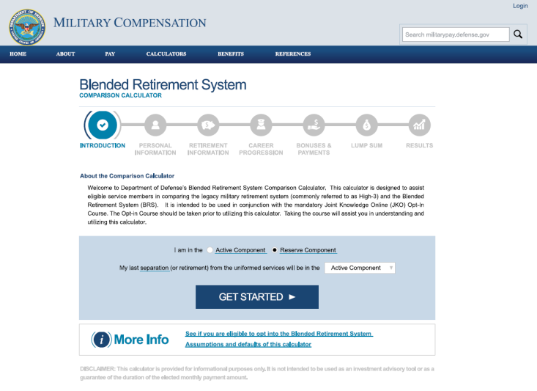
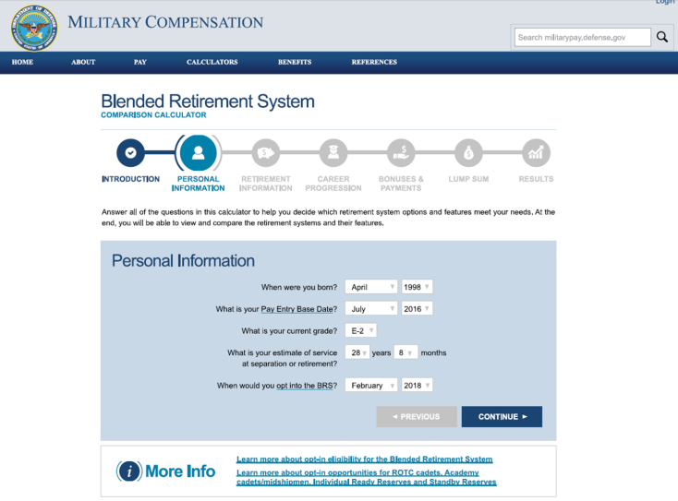
Comparison Calculator
Online BRS Comparison Calculator will allow service members to compare estimated benefits under both plans prior to making a decision
Walks service members through key information needed to make an effective comparison
Users can adjust data to see how changes to their career and savings will impact retirement benefits
Available Spring 2017
Video eTutorial will
accompany
calculator
Notes:
The official Department of Defense comparison calculator is the only calculator endorsed by the DoD for supporting a Service member’s Blended Retirement System opt-in decision.
However, Service members may use any calculator they feel can aide them in the decision making process. It is important to note, while other organizations have developed and fielded similar calculators, only the DoD Comparison Calculator has been validated by each of the Services, the Defense Finance and Accounting Service (DFAS) and the Department of Defense’s Office of Military Compensation Policy.

Slide 11
Blended Retirement System Benefits
Decision to opt-in is the member’s only – DoD has no preference
Greater portability of retirement benefits
Earlier savings for retirement
No longer ALL or NOTHING retirement plan
Covers more people
Recruiting incentive
Continuation Pay adds incentive to stay for full career
Lump Sum option gives choices at retirement
Encourages saving for retirement
Notes:
A few other items I’d like to briefly mention:
The Blended Retirement System does not change when a service member is eligible to retire.
Members covered by the Blended Retirement System may still elect to participate in the Survivor Benefit Plan.
The Blended Retirement System does not change the law on division of retired pay under the Uniformed Services Former Spouses Protection Act
Reservists covered by the Blended Retirement System are still eligible for reduced age retirement if they perform qualifying service.
Finally, a few closing thoughts.
There is no single right answer as to which retirement system is better. Both the legacy retirement system, often called the “High-3” system and Blended Retirement System may have advantages and disadvantages based on a Service member’s particular circumstances.
Those members who have the option of choosing their retirement system should base their decision entirely upon their own circumstances, after completing the training and taking advantage of all of the information and resources available.
For some, staying under the legacy retirement system will make sense. For others, the Blended Retirement System will be a preferable option.

Slide 12
Questions
January
1
2018
http://militarypay.defense.gov/blendedretirement
Notes:
Other Resources:
DoD Blended Retirement System Resource Webpage: http://militarypay.defense.gov/BlendedRetirement
Blended Retirement System Leader Course: (CAC required): https://jkodirect.jten.mil
Blended Retirement System Leader Course: (Non-CAC): http://jko.jten.mil/courses/brs/leader_training/Launch_Course.html
Military OneSource Website: www.militaryonesource.mil
A MyPay account is required to make BRS and TSP elections: https://mypay.dfas.mil
Information on TSP can be found at www.tsp.gov
Learn more about saving money, reducing debt, and building wealth: www.militarysaves.org

Slide 13
#blendedretirement
The Uniformed Services
Blended Retirement System
January
1
2018
BACKUP
PERSONNEL AND READINESS
Notes:
These back-up slides can be added to the main policy briefing to enhance delivery.

Slide 14
TSP Vesting
1% Automatic
Matching
begins
vested
begins
vested
Opt-In Members Serving as of December 31, 2017
immediately
next pay period after opt-in
2 years
beginning of 25th month of service
immediately
next pay period after opt-in
immediately
vested upon receipt
1% Automatic
Matching
begins
vested
begins
vested
New Accessions Who Join on or after January 1, 2018
60 days
60 days after entering service
2 years
beginning of 25th month of service
2 years
beginning of 25th month of service
2 years
beginning of 25th month of service
…vested means it’s yours to keep even after you leave the service.
Notes:
The term “vested” refers to the eligibility of service members to keep all the money from their TSP account when they leave the military.
For opt-in service members:
TSP participants are immediately vested in (entitled to) their own contributions and any government matching contributions.
However, service members must have at least two years of service in order to be vested in the government’s automatic 1% contributions and associated earnings in their account.
This does not mean two years from the date they opted-in or started the TSP, but it refers to total time in service. For example, if a members has two years and three months in service, they are considered vested in the government’s automatic 1% contributions and associated earnings .
For new accessions under BRS:
TSP participants will begin to receive the government automatic 1% of their basic pay after 60 days in service. Service members must have two years of service in order to be vested in the government’s automatic 1% contributions and associated earnings in their account.
At the beginning of two years of service, service members can begin matching contributions up to an additional 4% of basic pay. Service members are immediately vested in (entitled to) their own contributions and any government matching contributions at this point.

Slide 15
Opt-In Eligibility Choice
Serving as of December 31, 2017
if
As of December 31, 2017:
ACTIVE COMPONENT
Fewer than 12 Years Service
RESERVE COMPONENT
Fewer than 4,320 points
Why 4,320 points?
then
can
In CY18
Take Mandatory BRS
Opt-In Training in CY17
or
Do Nothing and Stayed Covered by Legacy System
Choose Blended Retirement System
Notes:
So thinking about how each individual circumstances are unique, we can walk through the eligibility chart for just about anyone and determine how they are impacted by the opt-in process. (Walk participants through opt-in eligibility chart).
Special note about the Reserve Component: The Reserve component is a bit unique in how eligibility is determined. This different eligibility criteria is based on language in the FY16 NDAA that mandated use of 10 U.S.C. §12733 to compute eligibility for Reserve Component Service members; it governs how years of service is calculated for a non-regular retirement.
For retirement, reserve service is converted to active service by dividing retirement points by 360. Remember, the military considers a month as 30 days for pay purposes, so each day is worth 1/30th of a month; 12 months would then equal 360 days. Thus, a Reserve with 4,320 retirement points equates to 12 years of active service.
I’d like to quickly play this DoD video which gives a fairly succinct overview of BRS.
Optional DoD Blended Retirement System video can be played here.
>To access: Click play button in PowerPoint or visit https://www.dvidshub.net/video/449935/2018-blended-retirement-system-explained

Slide 16
Lump Sum Option
Non-Regular Retirement
50% of future retired pay to age 67
NO LUMP SUM
GRAY AREA
Service Start
Retires
Age 60
Age 67
$
discounted present value
Reverts to Full Pension
$
Reduced Pension
LUMP SUM
GRAY AREA
Service Start
Retires
Age 60
Age 67
Age 67
Notes:
A non-regular retirement, often referred to as a “Reserve” or “Guard” retirement

Slide 17
Why 4,320 Points?
‘‘(2) ELECTION TO PARTICIPATE IN MODERNIZED RETIREMENT SYSTEM.—
‘‘(A) IN GENERAL.—Pursuant to subparagraph (B), a person performing reserve component service on December 31, 2017, who has performed fewer than 12 years of service (as computed in accordance with section 12733 of this title), may elect…
How do we interpret the statutory requirement to calculate YOS for reserve members?
10 U.S.C. §12733 mandates use of retirement points to determine the number of “years of service” for determining eligibility to opt into BRS
10 U.S.C.§12733 governs how YOS calculated for non-regular retirement
YOS derived by dividing total retirement points by 360
12 YOS = 4,320 points under this provision
Many RC members will be eligible based on points but have many more actual years of service for seniority
12 years
X 360
4,320
Notes:
Eligibility to opt-in is much broader for the Reserve component than active component. Unlike the Active component, where eligibility to opt-in is based on having served for less than 12 years, any Reserve component member with fewer than 4,320 retirement points as of December 31, 2017, will be eligible to opt-in during CY 2018, regardless of how many years they have actually been in the service.
This different eligibility criteria is based on language in the FY16 NDAA that mandated use of 10 U.S.C. §12733 to compute eligibility for Reserve component members; 10 U.S.C. §12733 governs how years of service is calculated for a non-regular retirement.
This differing criterion makes the pool of members eligible to opt-in to BRS much larger in the Reserve component ; but it is important to note these members will remain covered under the current retirement system unless they choose to opt-in.
Members of the IRR are also eligible to participate in BRS, but in order to elect to enroll in BRS they must be receiving pay (because of TSP). Therefore, members of the IRR who are eligible to enroll in BRS (because they are in the IRR as of December 31, 2017), but who do not drill in a paid status at all during calendar year 2018, will be allowed a one-time extension of the enrollment window beyond 2018.

Slide 18
Non-Regular Retirement
Example: O-5 retires after 22 years of service in the Reserve Component
1
2
3
4
Total Retirement Points
Divide by 360 to get equivalent Years of Service
Multiply Equivalent YOS by Retirement Multiplier
Multiply Percentage by Retired Pay Base
4,860 points
4,860 points
÷ 360
= 13.5 YOS
13.5 YOS
X 2.0%
= 27%
27%
X $8,900.50
= $2,403.14
monthly retired pay
Non-Regular Retired Pay begins at age 60, although this may be reduced as low as age 50 with certain creditable active service performed after the beginning of 2008
Retired Pay Base is the average of the highest 36 months of basic pay a member with equivalent grade and years of service (based on PEBD) would receive on active duty
Notes:
Assumes the member serves until YOS 30 in the Retired Reserve
Based on pay charts in place when member becomes eligible for retired pay
2015 – O-5 over 28
2016 – O-5 over 28
2017 – O-5 over 30
Notes:
Here is a quick review of how a non-regular retirement (often called a “National Guard” or “Reserve” retirement) works.
As a National Guard or Reserve member, you must have 20 “qualifying” years of service to be eligible for retired pay at age 60, although this may be reduced as low as age 50 with certain creditable active service performed after the beginning of 2008. A “qualifying” year is one in which you earn a minimum of 50 retirement points.
Remember, the military considers a month as 30 days for pay purposes, so each day is worth 1/30th of a month; 12 months would then equal 360 days(as opposed to 365 or 366 in a leap year).
The formula for computing equivalent years of service for Reserve retired pay is fairly simple:
Total number of Retirement Points, divided by 360.
The formula computes the number of equivalent years of service the member has completed (comparable to full-time service). For example, 4,860 points equals 13.5 years.
The legacy retirement system often called the High-3 and the new Blended Retirement System use the same calculation for determining a non-regular retirement; the only differences in the multiplier--under BRS it is 2 percent.

